Slide 1

Presented By: B. Jagadish Kumar
DATA ANALYSIS ON
AIR-LINE PRICING PATTERN
Exploratory Data Analysis & Visualization Project

Slide 2
About me
I am Bode Jagadish Kumar, a recent graduate with a Bachelor of Technology in Computer Science, from Kallam Haranadha reddy Institute of Technology.
Why Data Science?
I chose Data Science because it blends problem-solving, technology, and decision-making—three things I truly enjoy. I love working with data to find patterns and use them to solve real-world problems. It’s a field full of learning, innovation, and impact across industries.

Slide 3
AI Job Trends Dataset Analysis
To analyze the pricing pattern of the Airlines in the dataset. And the factors influencing the price.
The dataset helps understand the pricing pattern and how An Airline different from the other .Also how price varies from one to Another
The dataset contains 3,00,134 rows and 12 columns.
It includes 4 numerical columns and 6 categorical columns such as price, duration, and stops.
Key Features Include:
Airline, Flight, Source city, Destination city , Arrival time, Departure time
Several columns contain missing values that require appropriate imputation strategies (e.g., using mode or median).

Slide 4
Understanding the Columns:
S.No | Column Name | Missing Values | Data Type | Data Quality Issues | Cleaning/Preprocessing Required | Importance
1 | Flight | Few | Categorical (String) | Duplicates possible | Remove duplicates if necessary | Flight identifier, useful for airline mapping
2 | Airline | Yes | Categorical (String) | Nulls | Fill nulls using Flight prefix | Helps analyze fare differences across airlines
3 | Source City | No | Categorical (String) | None | Label encode if needed | Shows where flights originate
4 | Destination City | No | Categorical (String) | None | Label encode if needed | Shows where flights land
5 | Route | No | Categorical (String) | None | Combine source & destination | Useful for busiest routes analysis
6 | Departure Time | No | Categorical (Time Bucket) | Redundancy (Morning vs Early Morning) | Merge similar categories | Captures time-of-day trends
7 | Stops | No | Ordinal Categorical / Numeric | Needs conversion | Map (Non-stop=0, 1 stop=1, etc.) | Indicates travel convenience
8 | Duration | Yes | Real Numerical (float) | Nulls, skewness possible | Fill nulls, normalize if needed | Flight length analysis
9 | Price | Yes | Real Numerical (float) | Outliers present | Handle nulls & remove outliers | Central to fare prediction
10 | Class | No | Categorical (String) | None | None needed | Distinguishes Economy vs Business

Slide 5
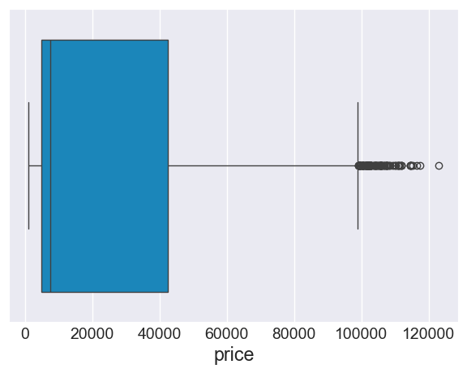
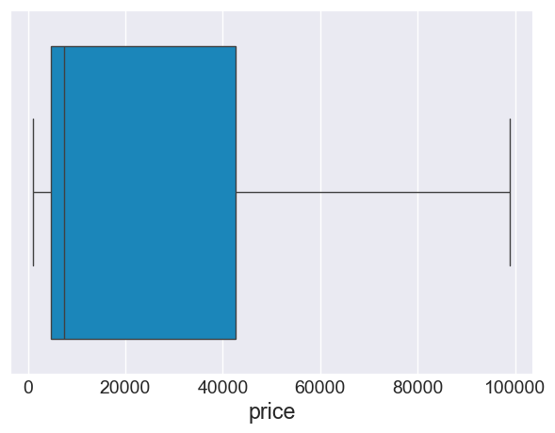
Handling Outliers
Outliers are data points in the Flight dataset that deviate significantly from other records and may affect analysis quality.
In Flight data, outliers occured in price(e.g.,The maximum price is > 1,20,000/-).
Unusual duration values (e.g., extremely high minutes or mismatched formats) act as outliers.
Outliers can misrepresent content distribution trends if not checked.
They are detected using statistical techniques and removed/standardized where necessary.

Slide 6
Data Cleaning & Preprocessing:
Handling Missing Data:
6004 rows of missing data in the flight dataset present in the columns : Airlines , price , duration.
With the help of unique flight code in the flights column we identified and filled the null values with its respective flight code
By using the price of the existing flights with same airlines ,filled the price with the Median
By the duration of the existing flights with same Airlines, filled the duration with its Median
Handling Duplicates:
There are `6022` Duplicated rows in the dataset.
Removed duplicates using a method .

Slide 7
Fixing Inconsistencies in Categorical Data:
Inconsistencies occur when the same category is represented in multiple forms due to formatting differences.
Standardized categorical fields like arrival time.
Combined both the Morning and Early morning to single category as their price average is similar
Data Type Conversion:
Data type conversion ensures columns are stored in the correct format for accurate analysis.
Converted stops column to Numerical column for further numerical analysis that supports more plotting
.

Slide 8
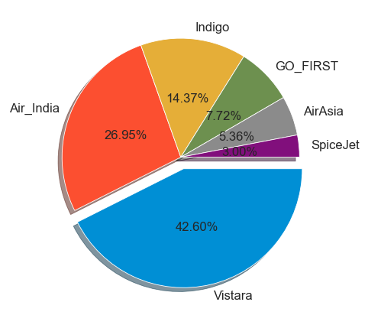
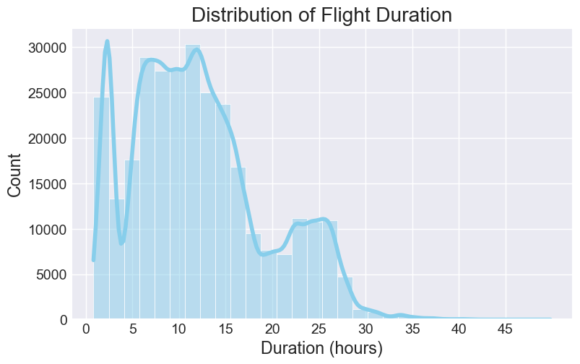
Univariate Analysis
Univariate analysis examines a single variable at a time to understand its distribution and frequency.
Showed that Movies dominate over TV Shows in the dataset.
release_year analysis revealed most titles were added after 2010.

Slide 9
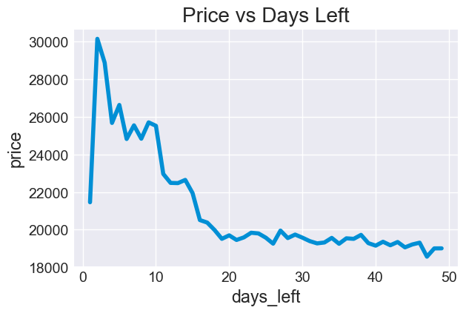
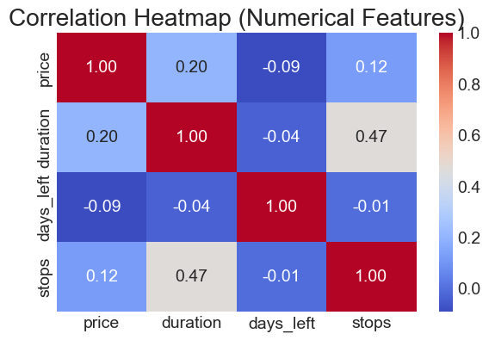
Bivariate Analysis
Bivariate analysis studies the relationship between two variables to identify associations, trends, or dependencies.
1. Numerical vs Numerical:
release_year vs engaging_minutes indicated most titles clustered between 90–120 minutes in modern years.

Slide 10
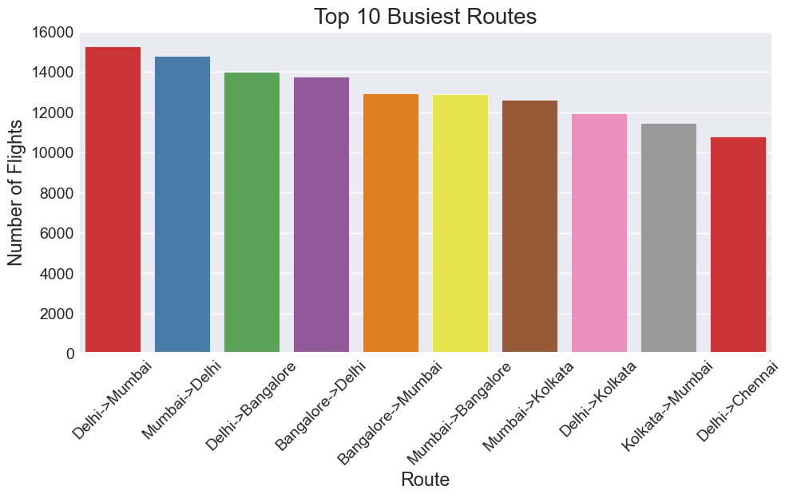
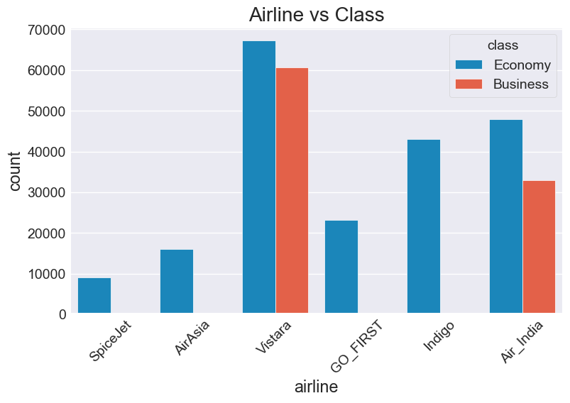
2. Categorical vs Categorical
type vs rating showed that TV-MA and TV-14 dominate across Movies and TV Shows.

Slide 11
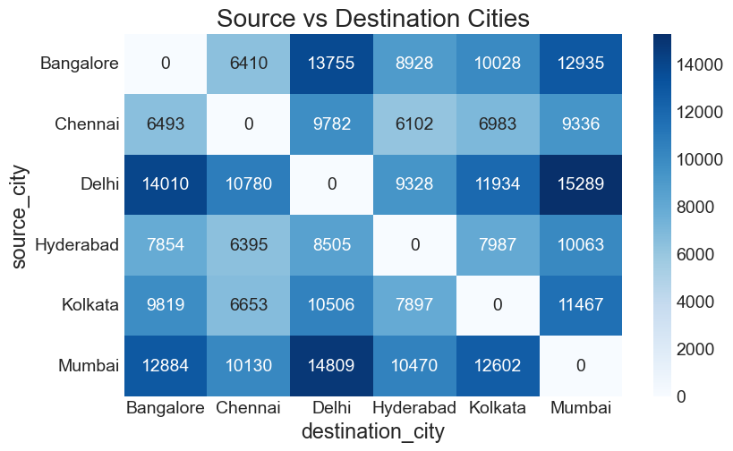
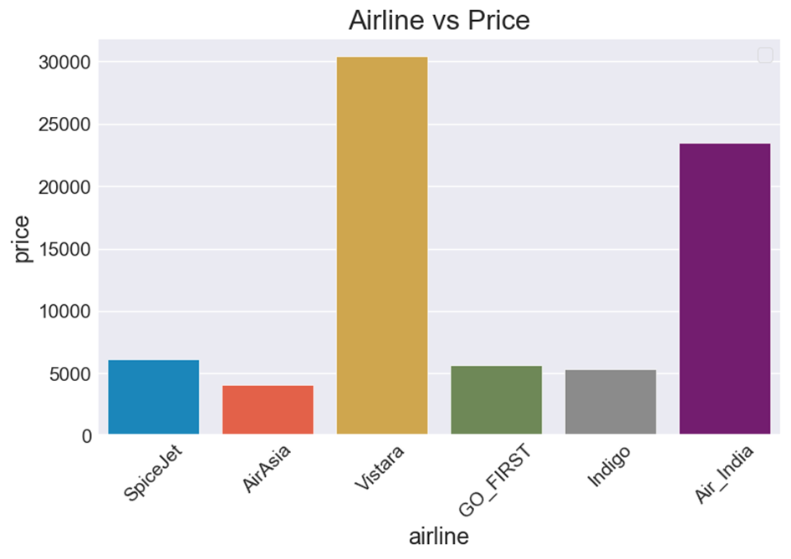
Categorical vs Categorical

Slide 12
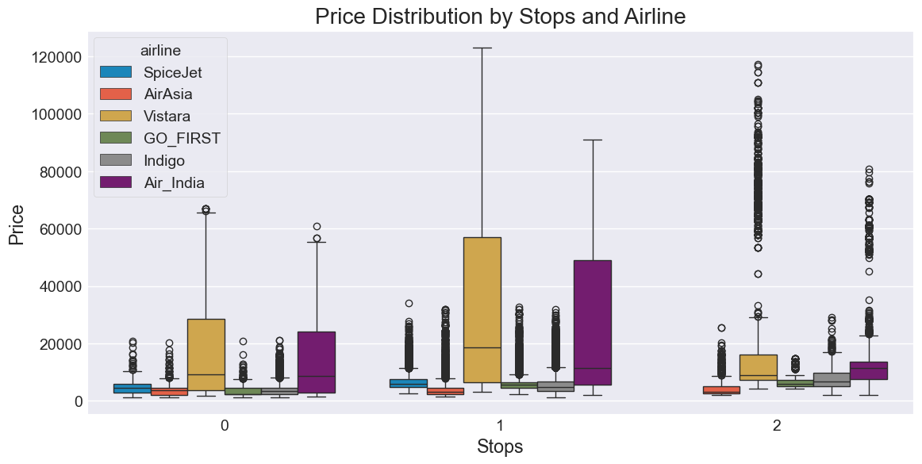
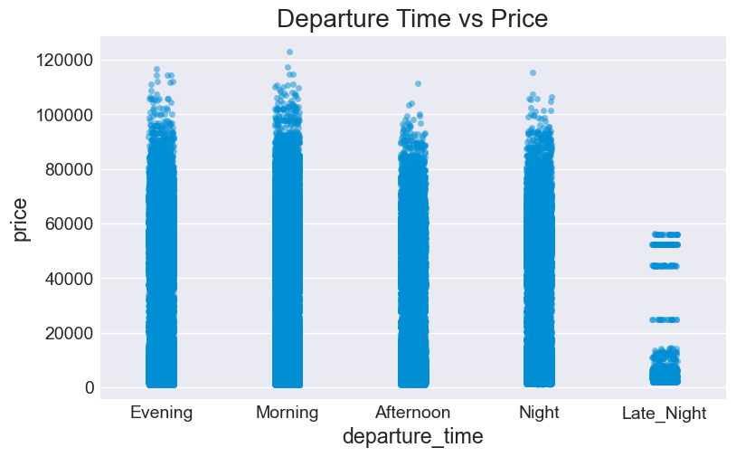
3. Numerical vs Categorical:
type vs release_year revealed that TV Shows increased steadily in recent years compared to Movies.

Slide 13
Problem Statement:
Problem: what is the price variance of different Airline to a particular route?
Goal: By finding minimum we can Identify which Airline having low price.
Problem: Is days left impacting the price of the ticket
Goal: Evaluate the correlation between days left and price.
Problem: which Airlines travel the most and which route is busiest?
Goal: Find the count of the destination city and the highest will appear on the top.
Problem: To find out the best flight with less duration and moderate price?
Goal : To set the duration to Minimum and find the flight with moderate price to the required destination.
Problem: Is there a relationship between days left and price demand?
Goal: Analyze the price difference for number of days left for every flight.

Slide 14
Insights
Business class fares ~150–200% more than Economy
Delhi–Mumbai and Bangalore–Delhi → busiest routes
Non-stop flights = faster, but more expensive
Prices depend on: Duration, Class, Route, Days Left

Slide 15
Conclusion
AI is transforming the job market, but many roles are evolving, not disappearing.
Moderate AI impact jobs show the highest future growth and stability.
Higher education and continuous learning reduce the risk of automation.
A balanced view of salary, demand, and automation risk is key to identifying future-proof careers.

Slide 16
Future Scope:
We can develop a predictive model that estimates the future demand and risk level of job roles based on AI impact, industry type, and experience.
We can build a career recommendation engine that suggests roles with high future demand and low automation risk, based on a user’s background.
We can create an AI Awareness Dashboard for job seekers and companies to monitor how AI is affecting different occupations in real time.
We can partner with educational platforms to design upskilling paths aligned with roles less likely to be automated.
We can develop a geo-based job trend analyzer, helping governments and companies understand AI-driven job shifts across countries and cities.
Above all, these features can be integrated into a single intelligent career assistant app, accessible to students, professionals, and policymakers.

Slide 17

THANK YOU

